Slide 1
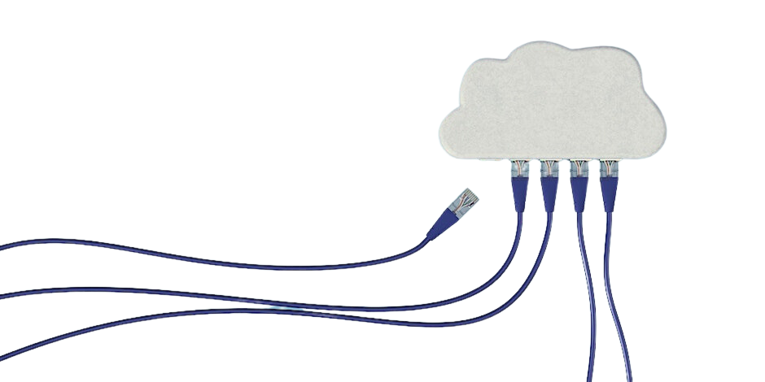
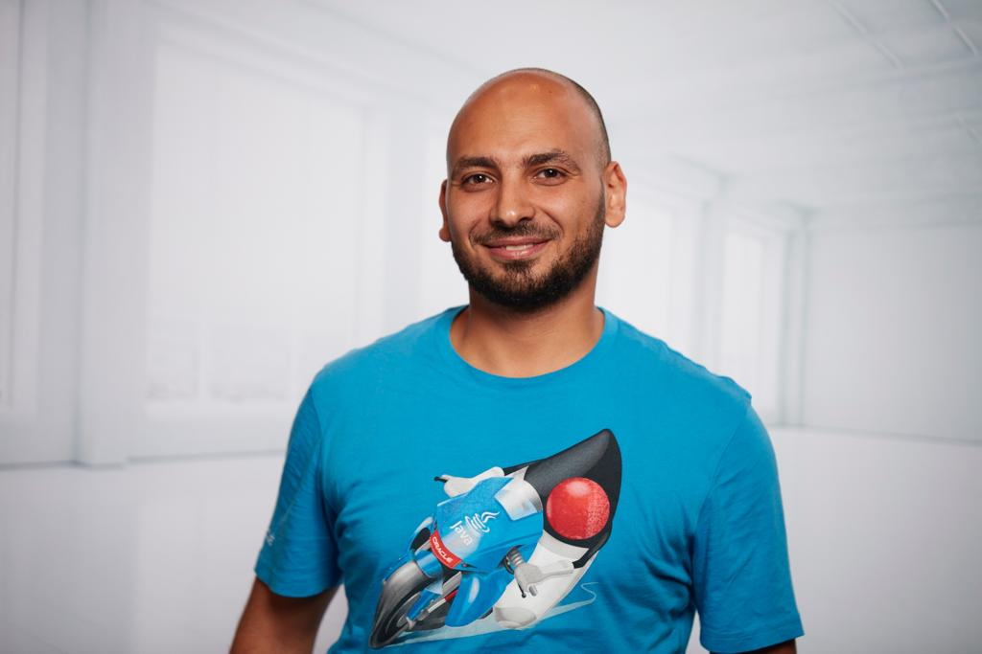


A Deep-Dive journey in Developing Microservices with Java, Spring Boot/ Cloud, Docker, Kubernetes
CLOUD DAY 2023
Ahmad Gohar
Senior Solution Architect@ IBM

Slide 2
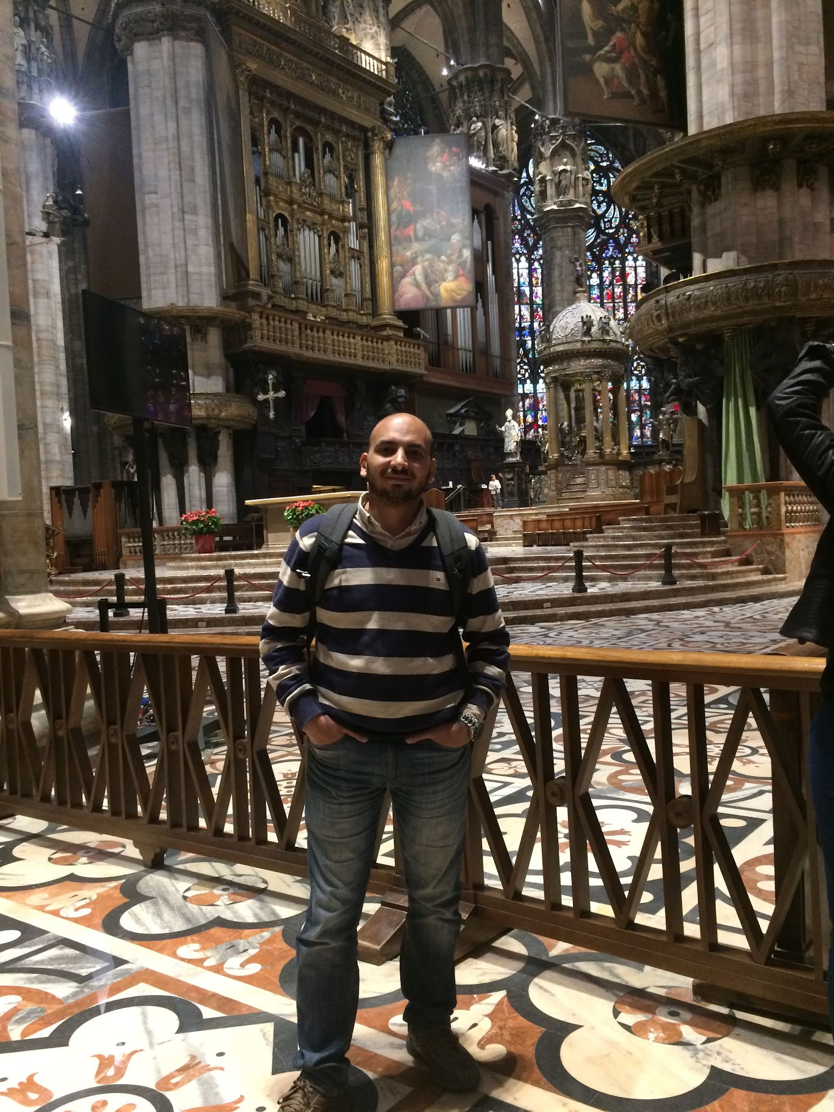
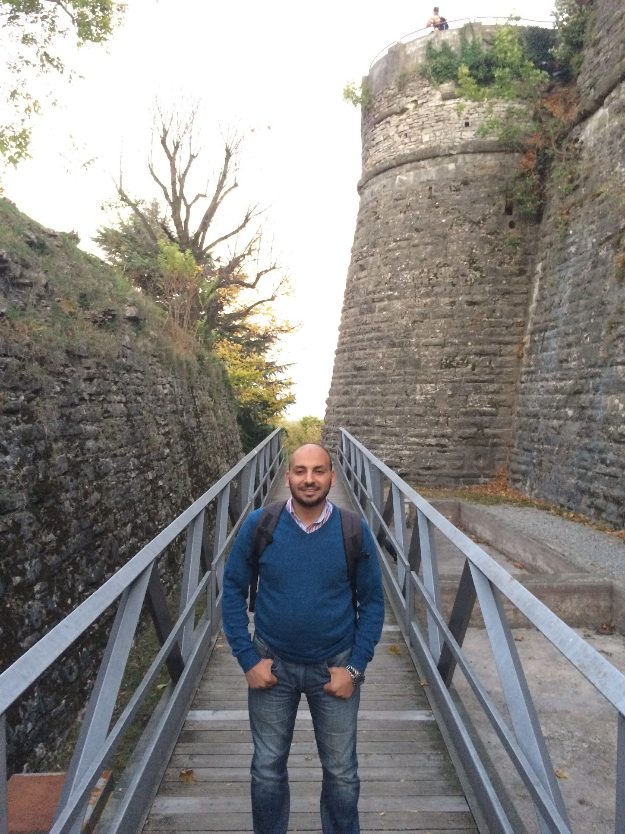
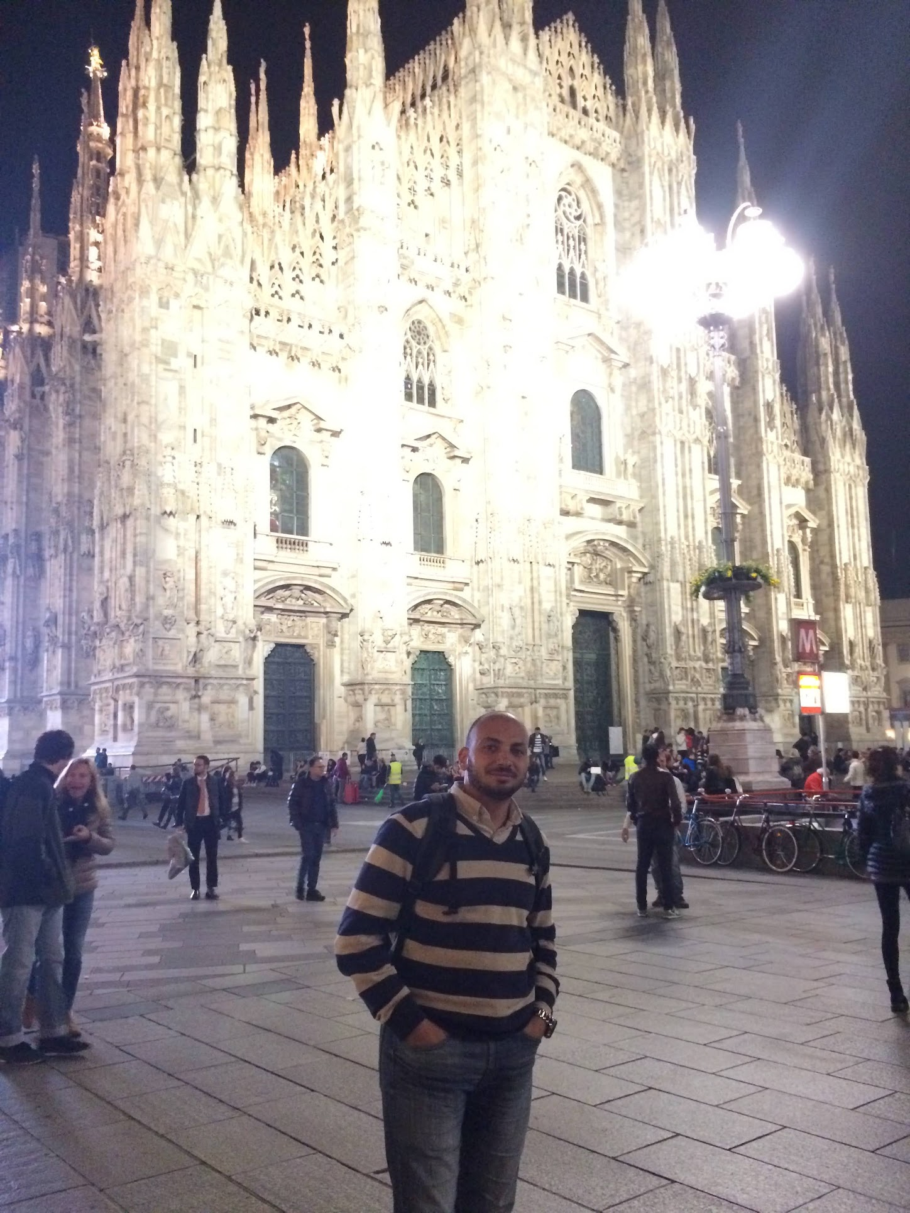

Slide 3










KUDOS

Slide 4
Our Journey Today
Business Case
Microservice Design
DAOs
Service Layer
Controllers
Microservice Architecture
Load Balancing
Service Discovery
Configuration Server
API Gateway
Containerization
Kubernetes & Helm

Slide 5
Business Case
3 Identified Microservices
User Profile Microservices
Microservice : user-profile-ms
Database Entities: users, user_address, user_payment
Order Management Microservices
Microservice : order-management-ms
Database Entities : orders, order_items
Product Catalogue Microservices
Microservice : product-catalogue-ms
Database Entities : product_category, product

Slide 6
Microservice Design
Controller
Service
Repository
Entity
Mapper
DTO
Exception Handling

Slide 7
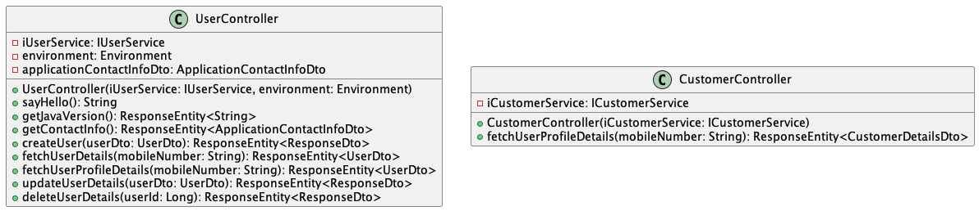
Microservice Design - Controller

Slide 8
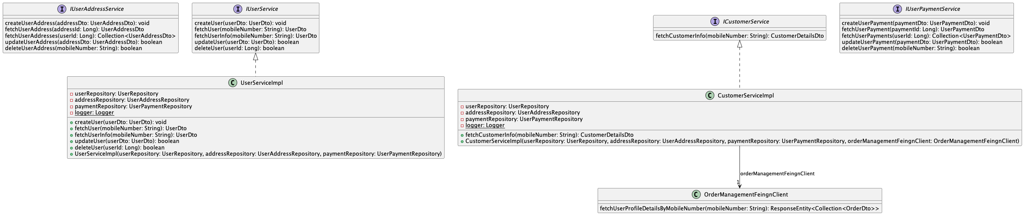
Microservice Design - Service

Slide 9
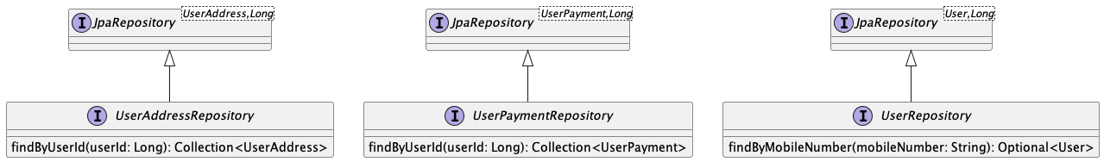
Microservice Design - Repository

Slide 10
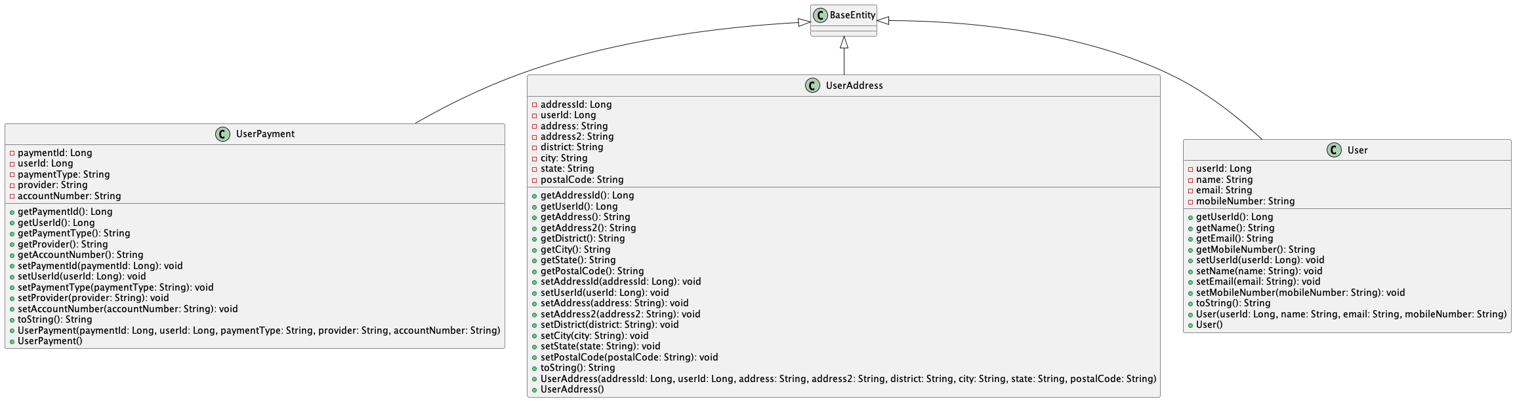
Microservice Design - Entity

Slide 11
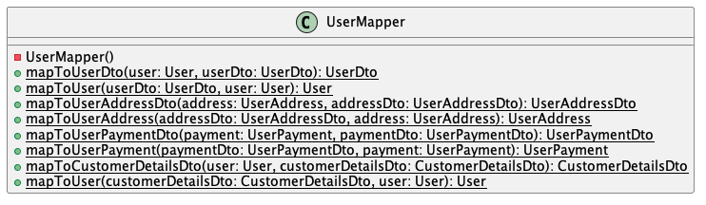
Microservice Design - Mapper

Slide 12
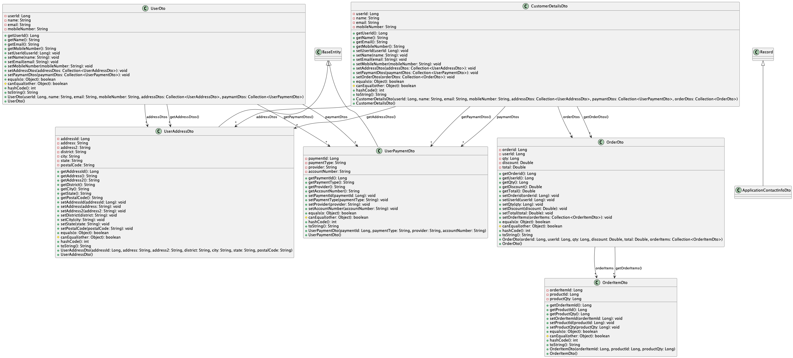
Microservice Design - DTO

Slide 13
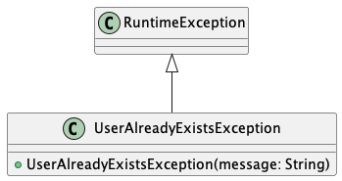
Microservice Design - Exception Handling

Slide 14
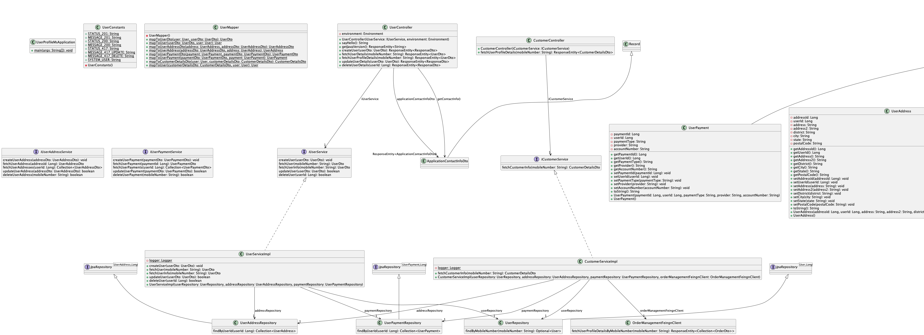
Microservice Design

Slide 15
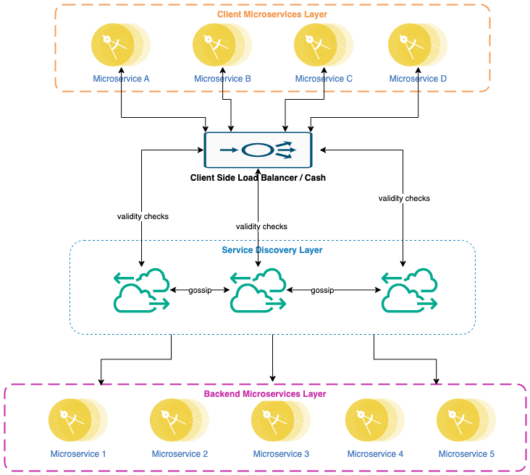
Microservice Architecture

Slide 16
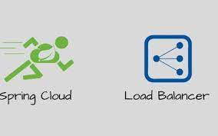


Load Balancer
Spring Cloud Load Balancer
Netflix Ribbon Client Side
Spring Web

Slide 17
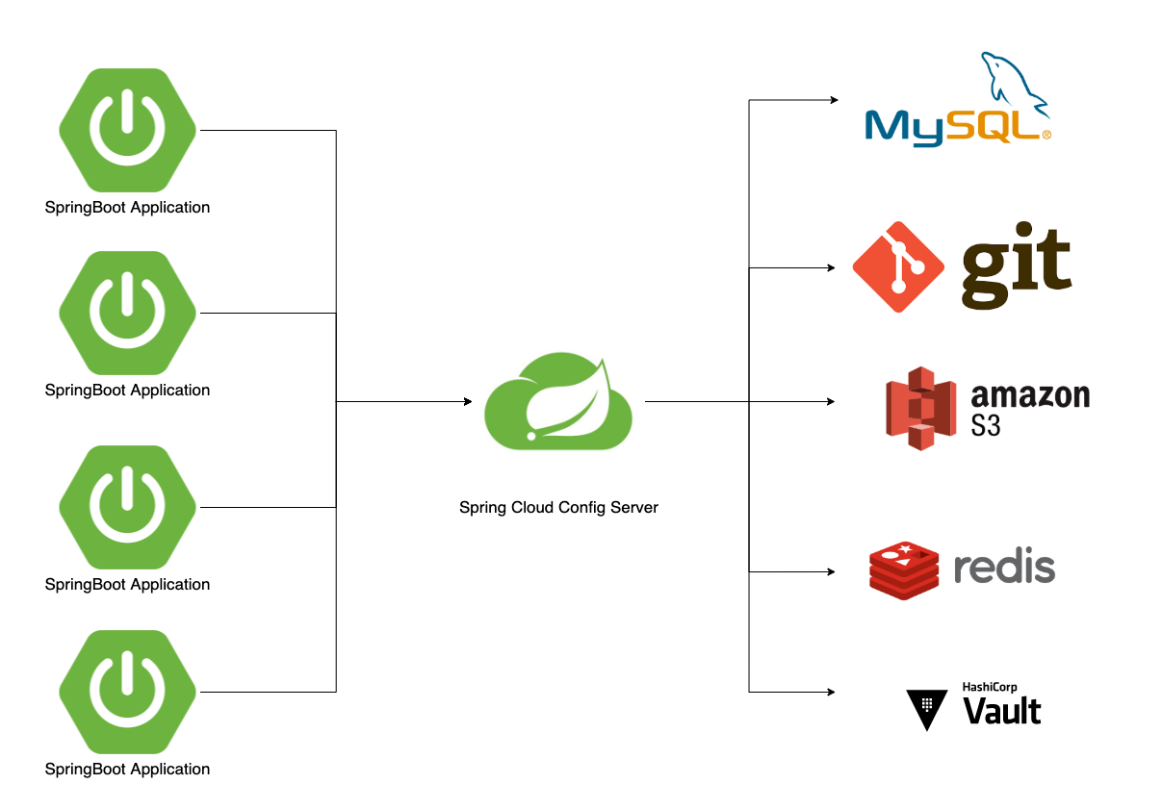
Spring Configuration Server
Notes:
https://medium.com/javarevisited/centralized-configuration-for-microservices-using-spring-cloud-config-c7845cbccc34

Slide 18
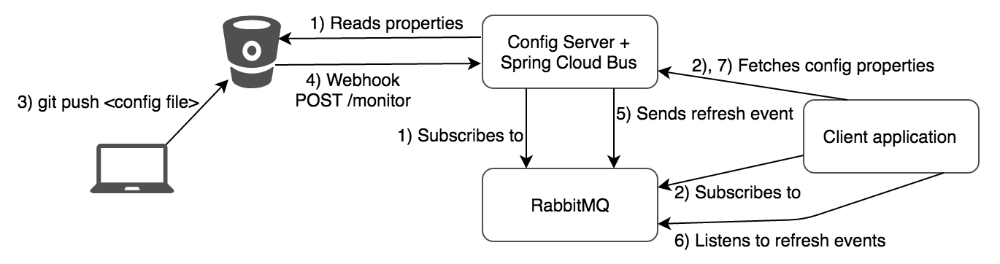
Configuration Server data update Mechanism

Slide 19




Service Discovery
Spring Cloud Netflix Eureka
Etcd
Consul
Apache Zookeeper

Slide 20

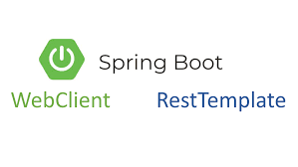
Service Lookup
Netflix Feign Client
RestTemplate
WebCLient

Slide 21


API Gateway
Spring Cloud Gateway
Zuul

Slide 22
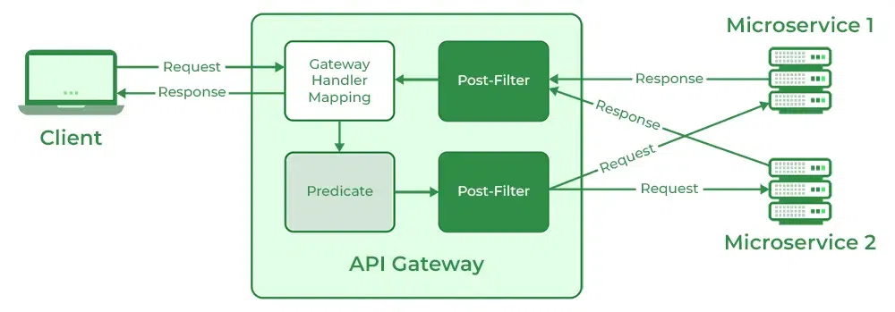
Notes:
https://www.geeksforgeeks.org/spring-cloud-gateway/

Slide 23
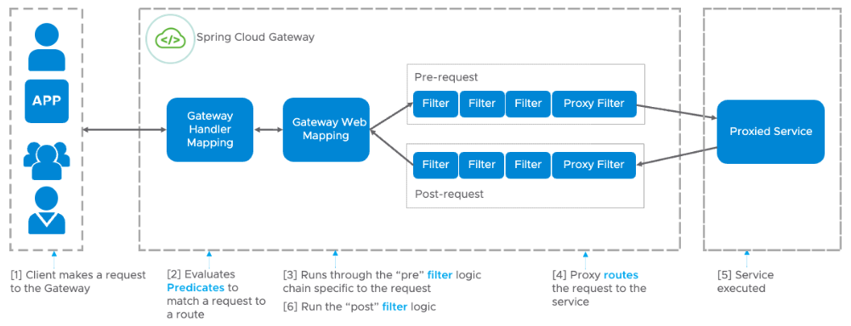
Spring Cloud Gateway custom Filter
Notes:
https://www.springcloud.io/post/2022-08/spring-cloud-gateway-filter/#gsc.tab=0

Slide 24



Fault Tolerance
Resilience4j
Netflix Hystrix
Sentinel

Slide 25
Resilience Best Patterns
Repository with all patterns mentioned
Rate Limiter
Bulkhead
Circuit Breaker
Retry
Timeout
All projects built with the following technologies:
Java 17
Spring Boot
Lombok
Spring Boot Actuator
Notes:
https://www.springcloud.io/post/2022-03/resilience-and-best-patterns/#gsc.tab=0

Slide 26
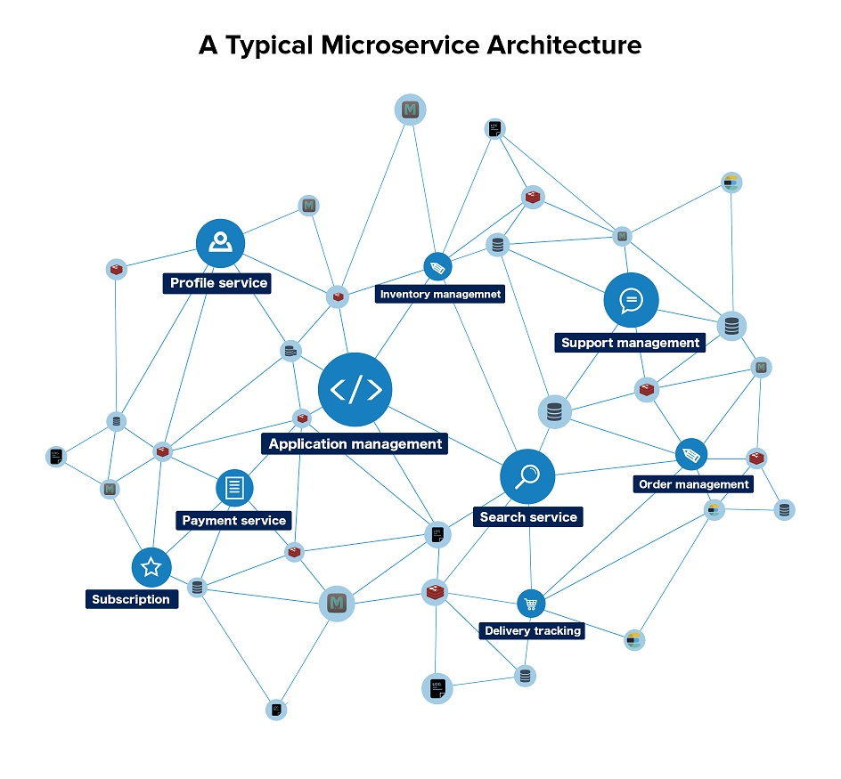
Observability & Monitoring
Observability
Logs
Metrics
Monitoring

Slide 27
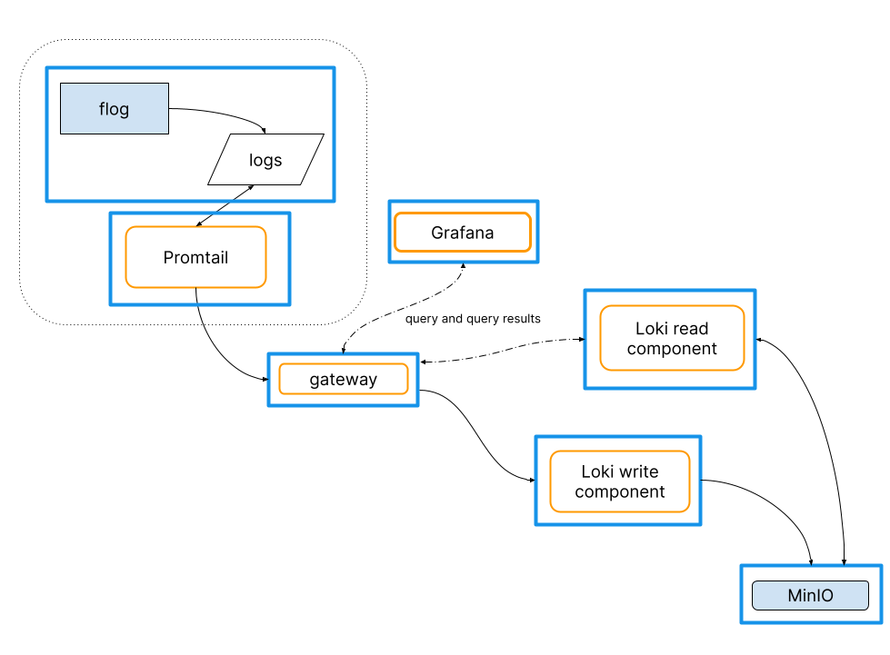
Log Aggregation

Slide 28
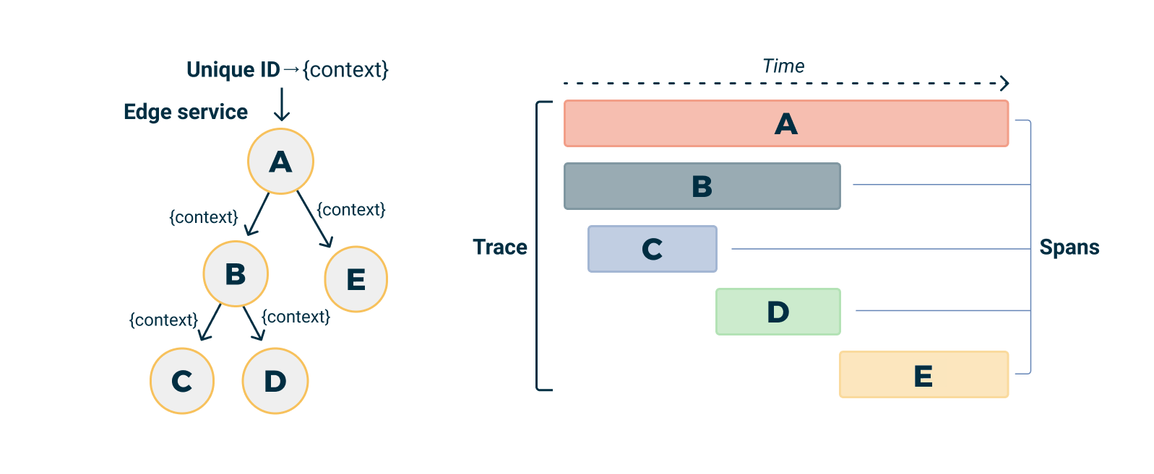
Distributed Tracing Best Practices
Application ID +
Correlation ID
Tag + TractID + Span

Slide 29
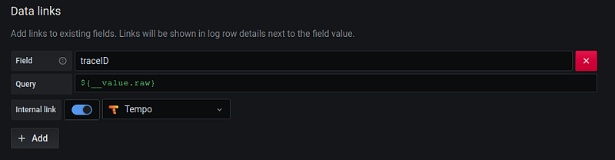
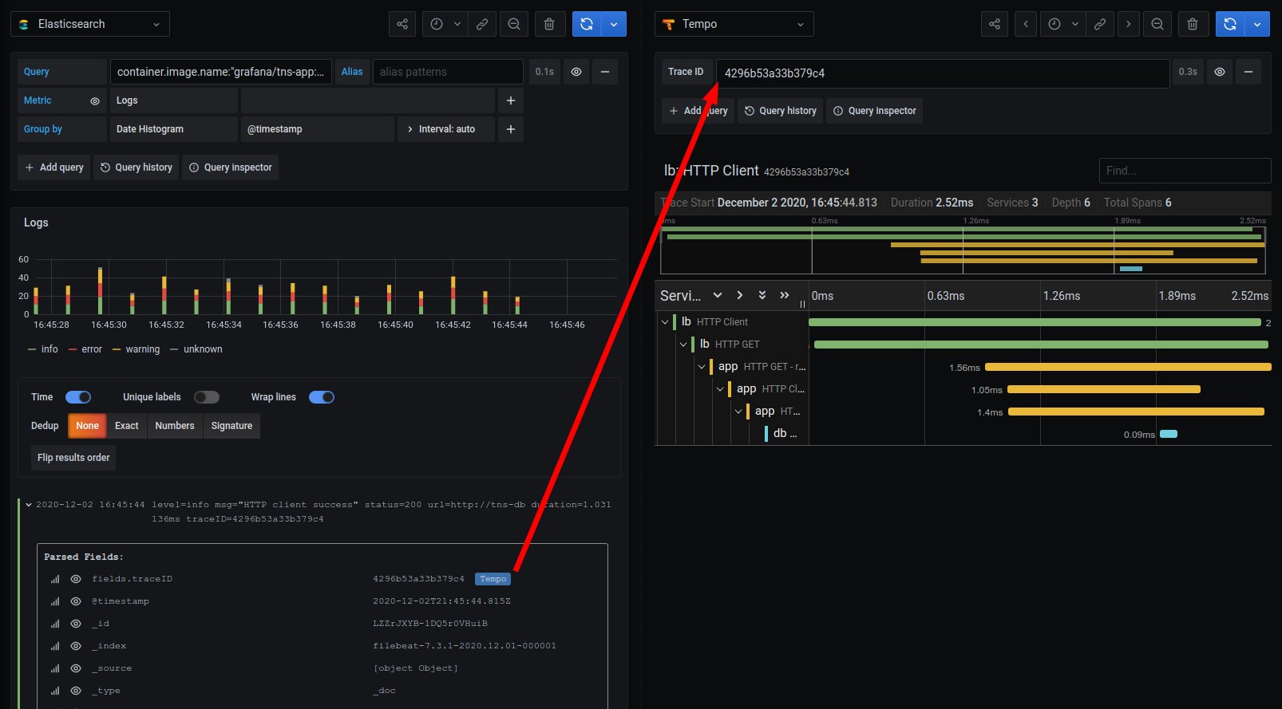
Grafana, Tempo
Notes:
https://grafana.com/blog/2020/12/07/how-to-find-traces-in-tempo-with-elasticsearch-and-grafana/

Slide 30
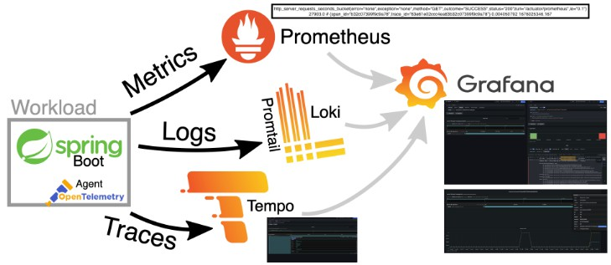
Distributed Tracing and Observability

Slide 31
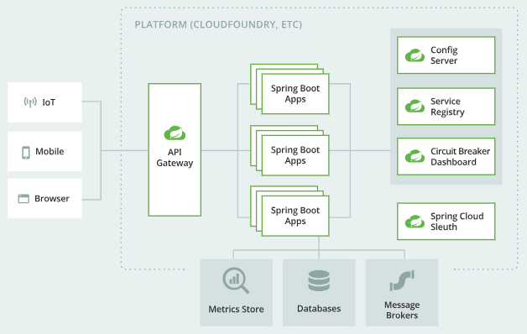
Microservice resilience with Spring Cloud
Notes:
https://www.sobyte.net/post/2021-07/spring-cloud-gateway-guide/

Slide 32
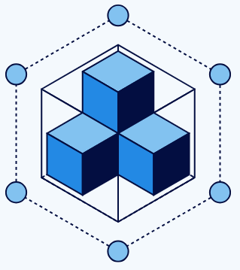
Containerization
Docker Image
Docker Engine
Container Orchestration
Automate Orchestration Activities

Slide 33
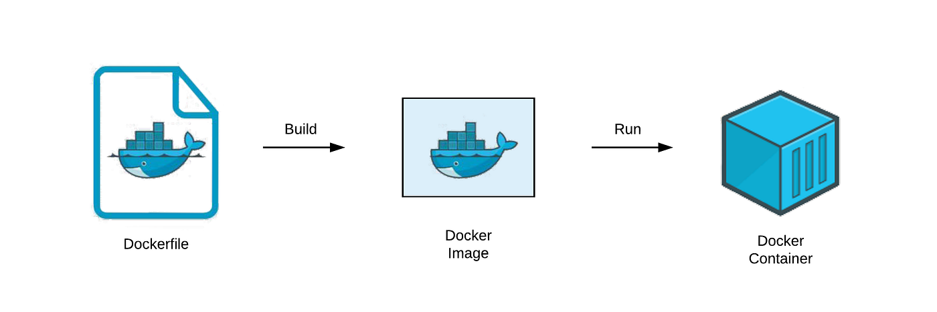
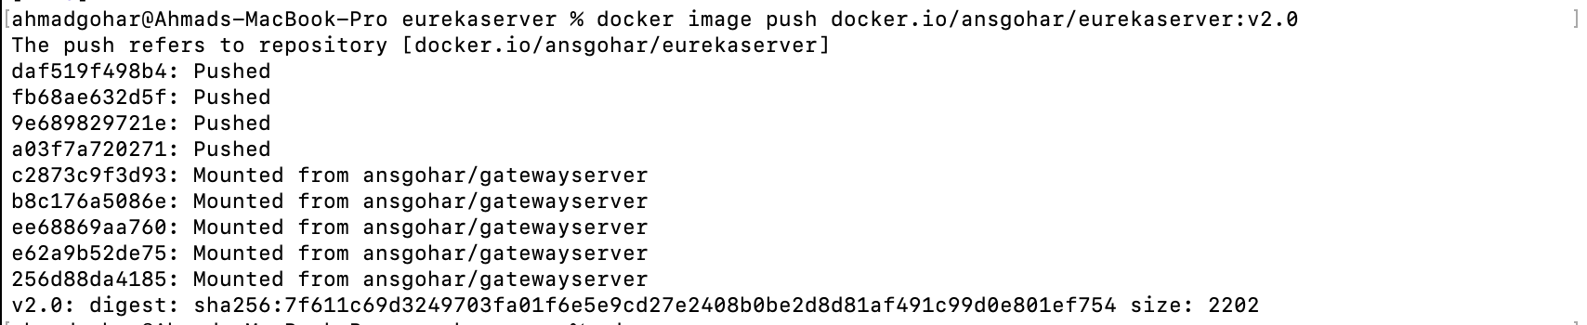
Docker Image
Dockerfile
Buildpacks
Goole Jib

Slide 34
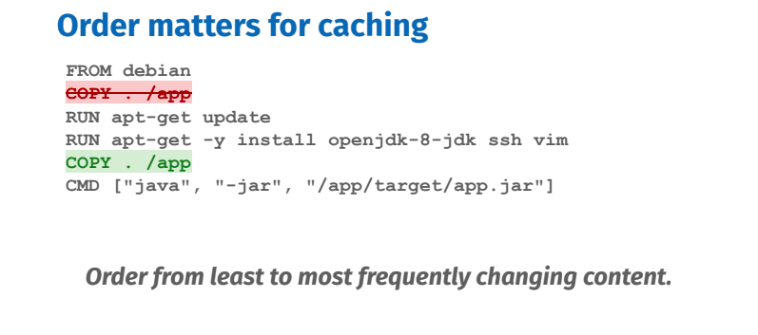
Traditional Dockerfile
docker build . -t ansgohar/user-profile-ms:v0.1
docker run -d -p 8080:8080 ansgohar/user-profile-ms:v0.1
docker image push docker.io/ansgohar/user-profile-ms:v0.1

Slide 35

Buildpacks
mvn spring-boot:build-image
docker image push docker.io/ansgohar/user-profile-ms:v1.5

Slide 36
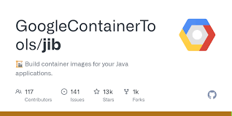
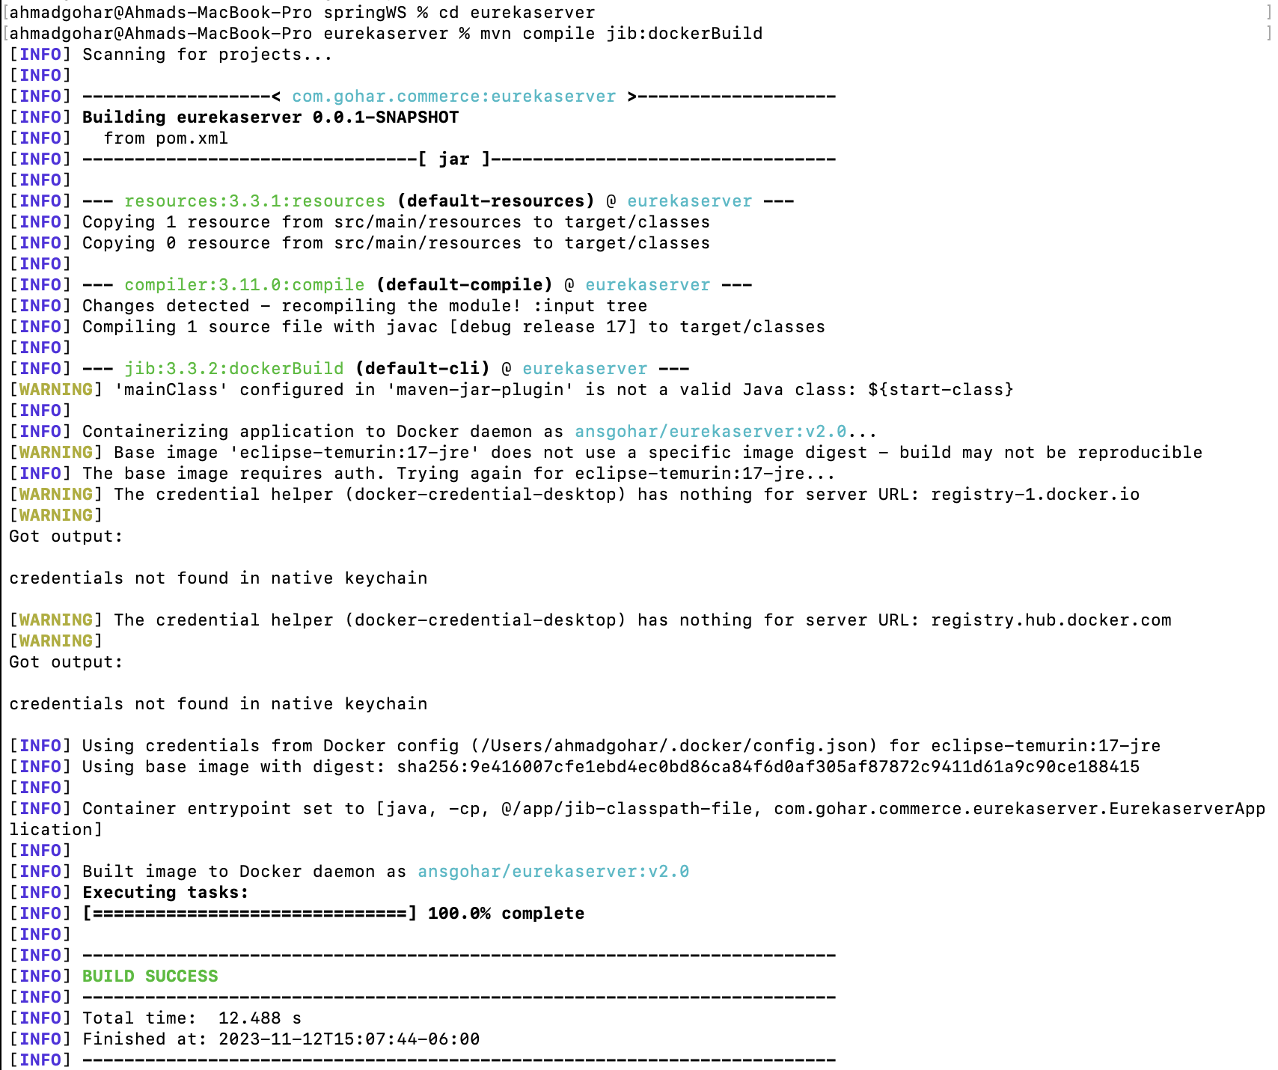
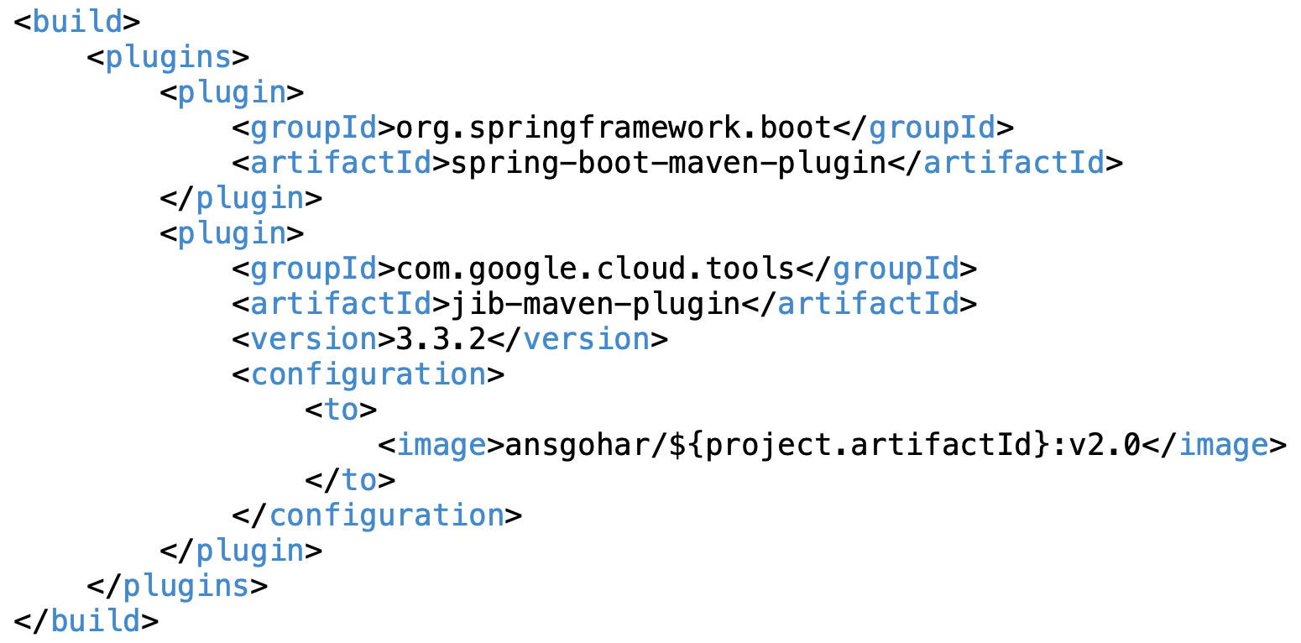
Google Jib
mvn compile jib:dockerBuild
docker image push docker.io/ansgohar/user-profile-ms:v2.0

Slide 37
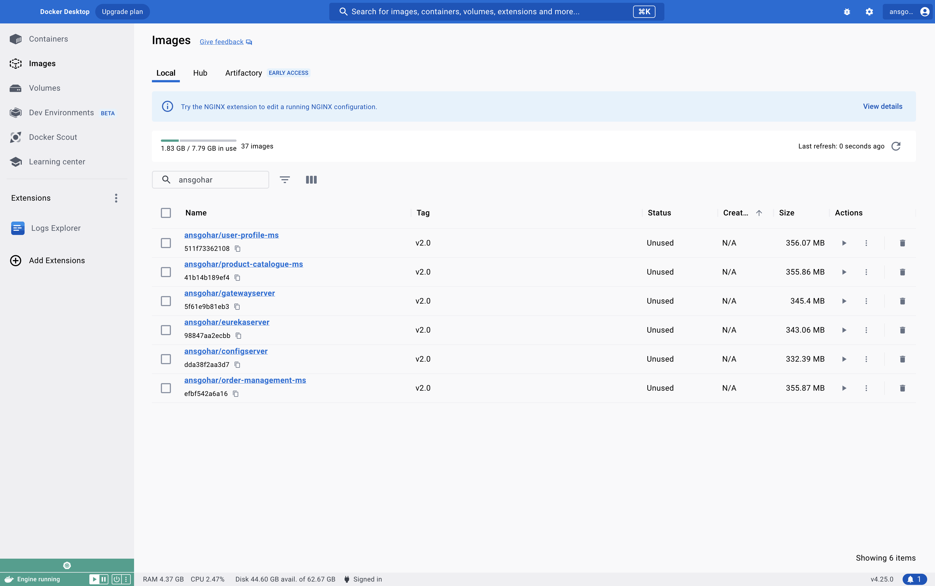
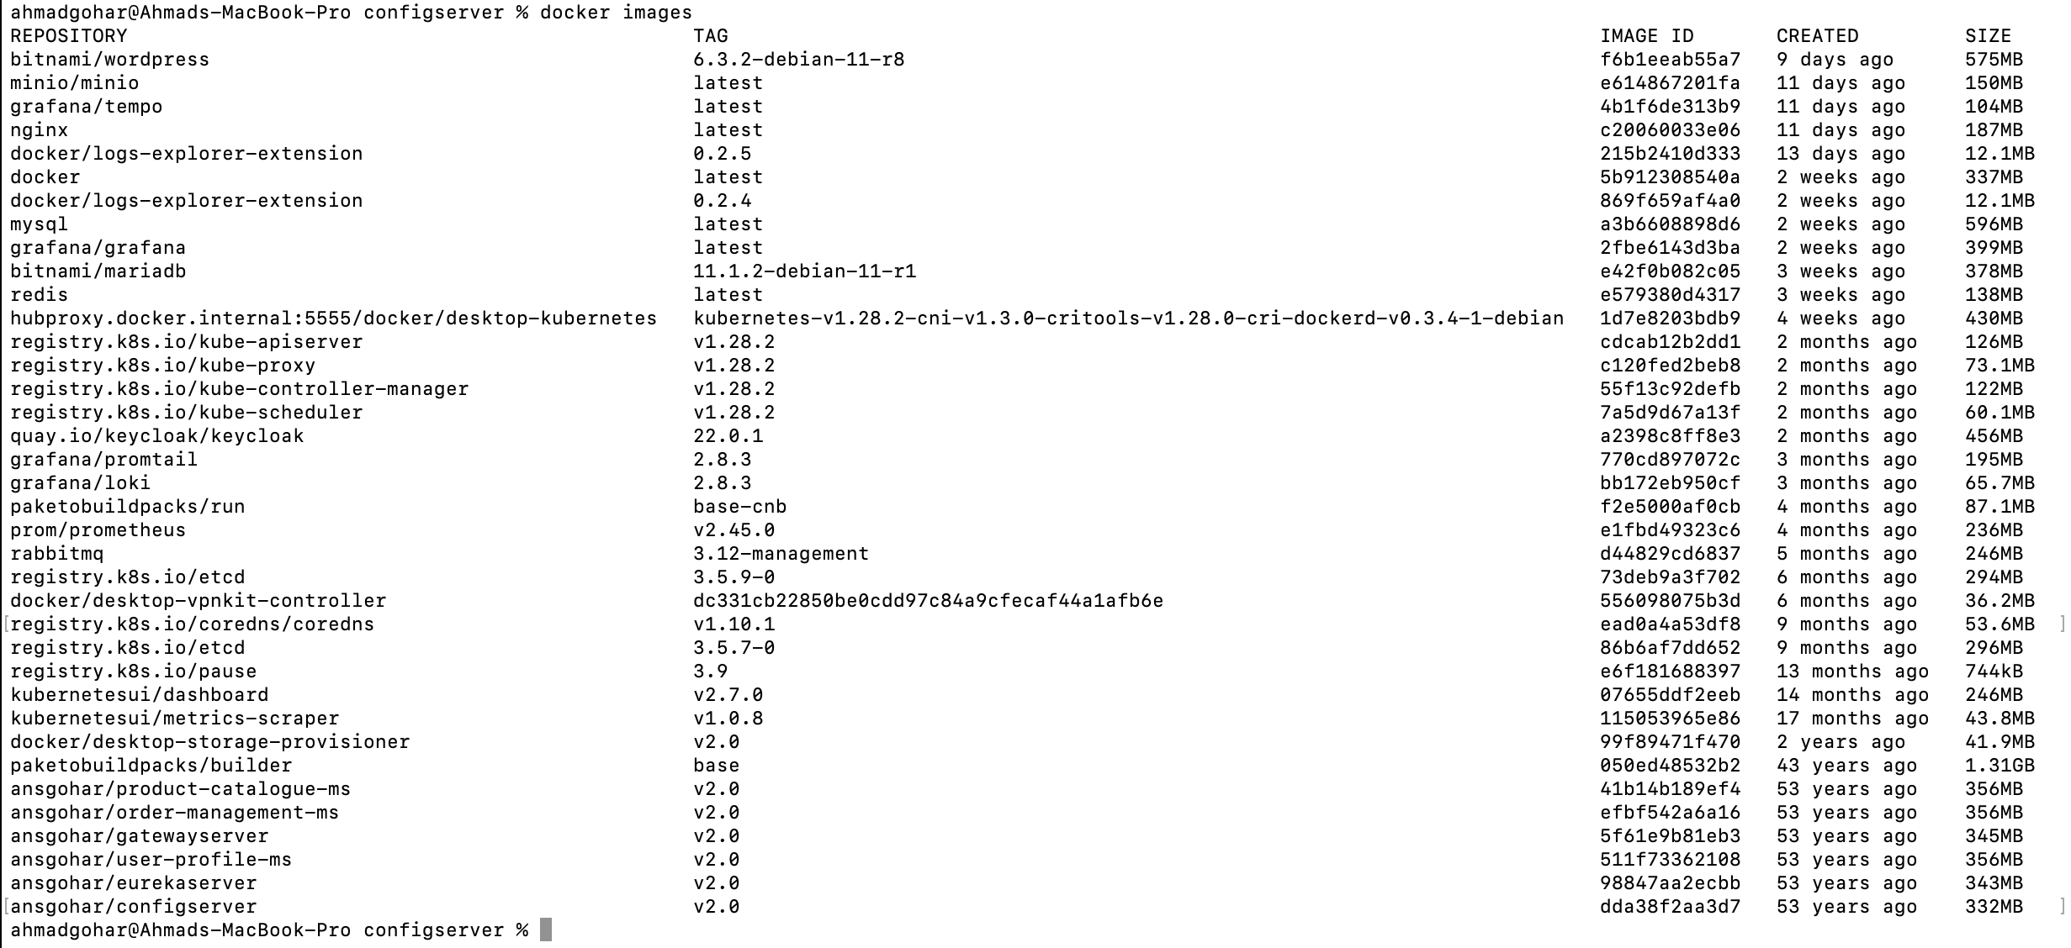

Slide 38
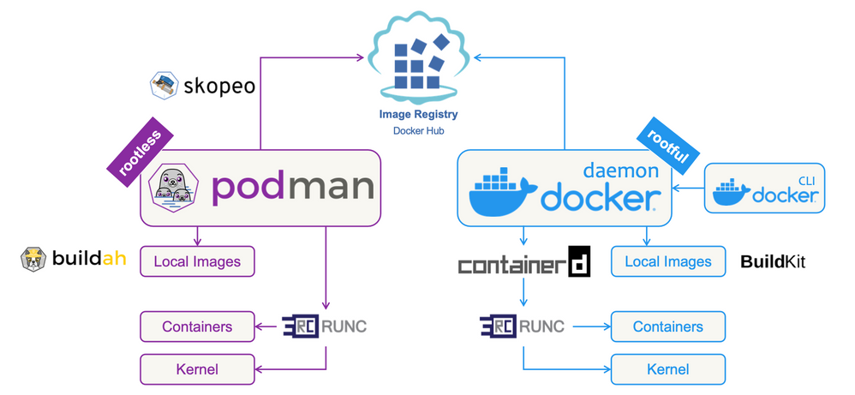
Containerization Engine
Docker
Podman

Slide 39


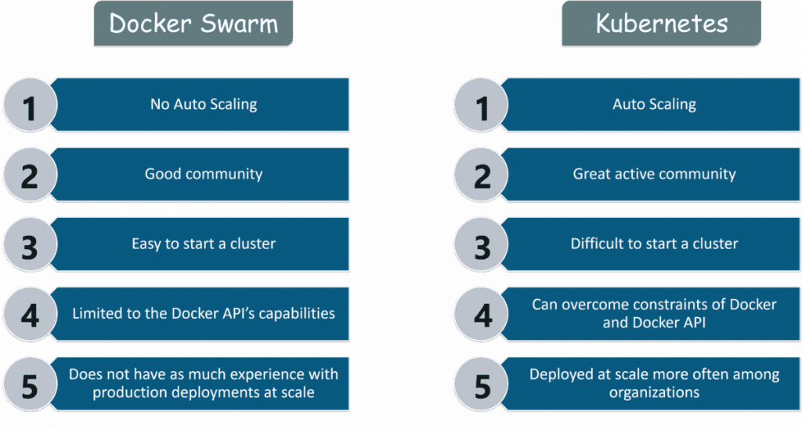
Container Orchestration
Docker Compose
Kubernetes K8S

Slide 40
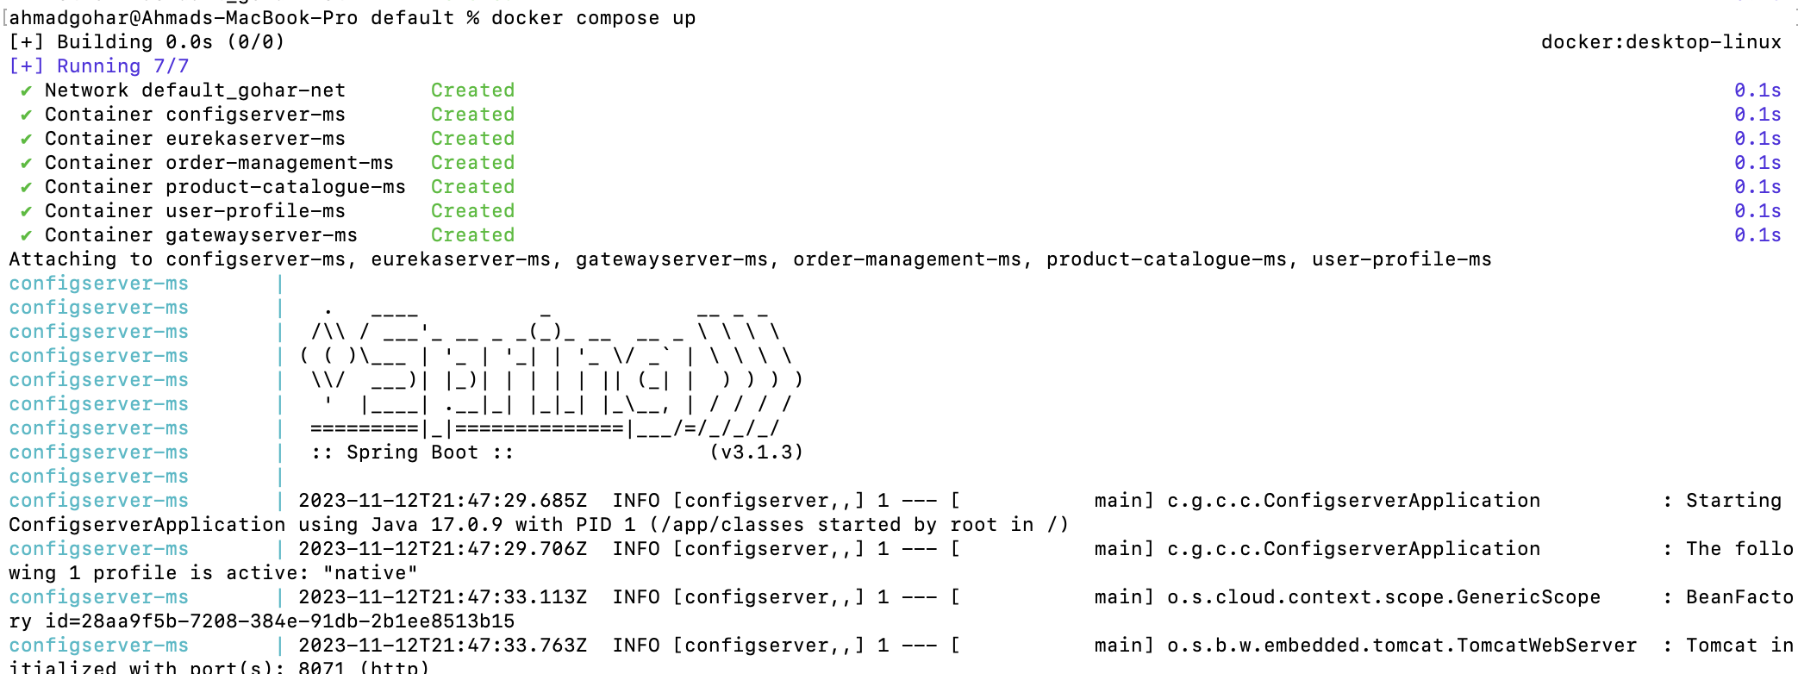
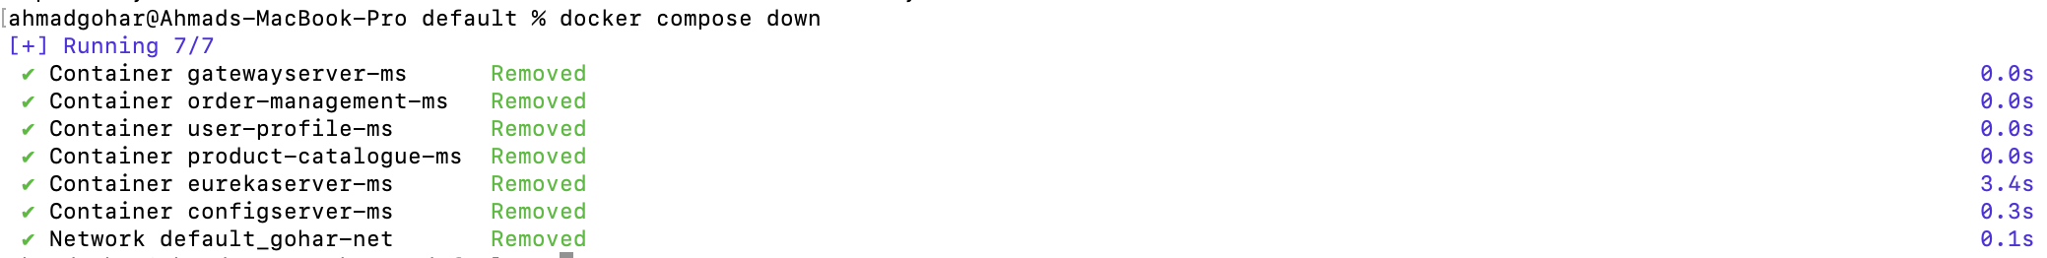
Docker Compose

Slide 41
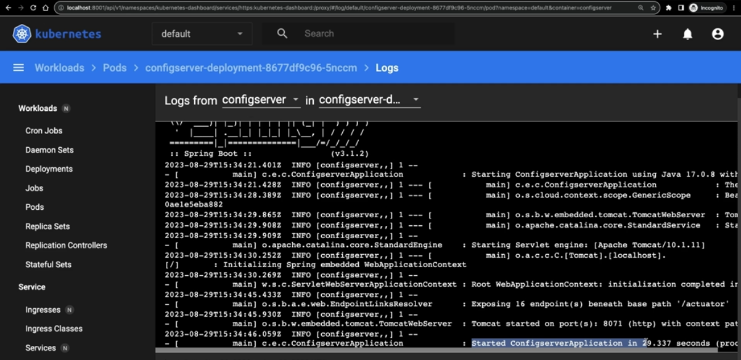
Kubernetes K8S
Kubectl apply –f 3_configserver.yaml

Slide 42
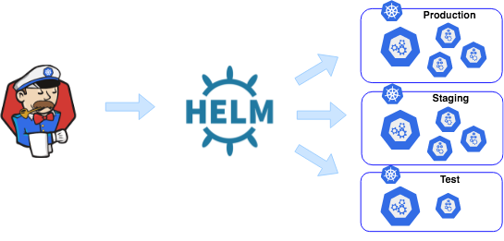

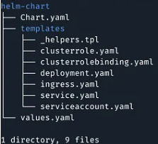
Helm
Build the dependencies
Helm dependencies build
Actual manifest file
Helm template .
Install the microservices
Helm install gohar prod-env

Slide 43
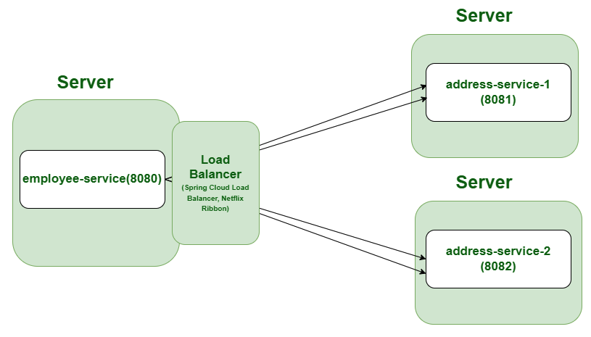
Service discovery and Load Balancing Client Side

Slide 44
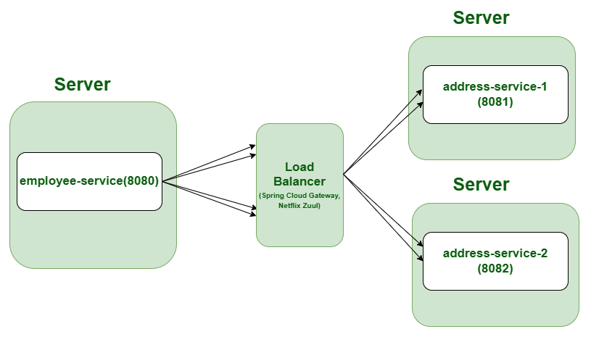
Service discovery and Load Balancing Server Side

Slide 45
GRAZIE!
CLOUD DAY 2023

